Slide 1
Some AMS Basics
2022
Melissa Faehrmann
Antimicrobial Stewardship Pharmacist, The Canberra Hospital

Slide 2
Learning Objectives
Develop an understanding and awareness of the antimicrobial stewardship procedure at CHS.
Develop an understanding of how to prescribe using protocols and specialty approval codes.
Familiarise staff with after hours processes to prescribe and access restricted antimicrobials.
Understand the role of medical, nursing and pharmacy staff in implementing the AMS procedure.

Slide 3
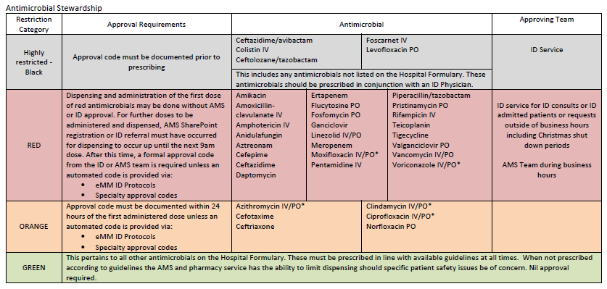
AMS Categories (pg 11 SOP)
Notes:
Some new blacks
Gent and Tobra are now greens

Slide 4
AMS Codes:
Day
Month
XX-070505R
Initials
(of approver)
Duration of code
Notes:
This is what a code means: the first 2 letters are the initials of the person approving. Day and month of when the approval given
The last number is the number of days that it is approved from. This counts from the day the code is given and lasts until 2pm

Slide 5
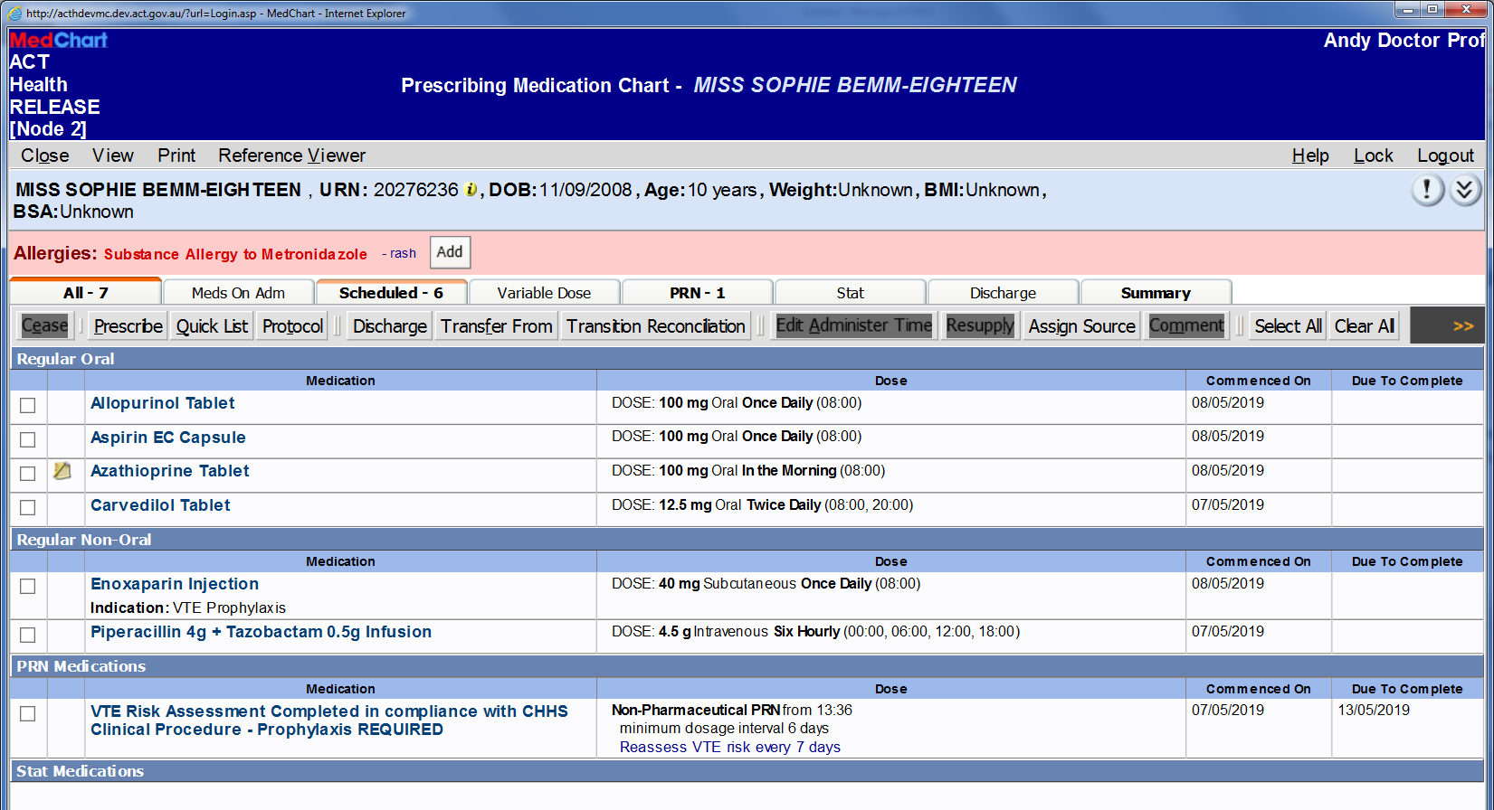
Where to find and document codes on eMM

Slide 6
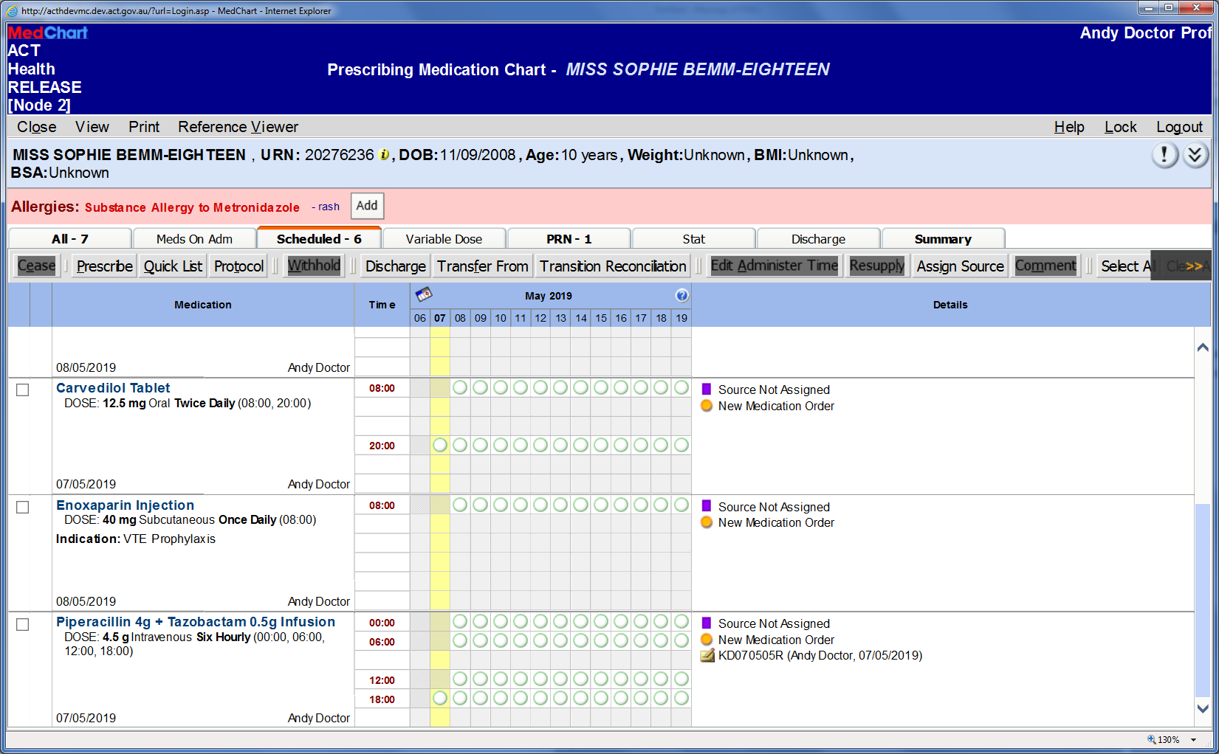
How to add/view comments (e.g. AMS codes or pharmacist advice)

Slide 7
For Mos To Obtain Codes
Protocol Prescribing
Specialty Approval Codes (FNDDMM05R, BITDDMM03R)
AMS Sharepoint (call 43378 if adding after 2pm)
ID Consult (REDCap)
After hours:
Nights – add to AMS Sharepoint (if no code or protocol)
Weekends – registrar to call ID Consultant on Call to discuss clinical picture and codes (if no code or protocol)

Slide 8
eMM Protocols
>130 pre-populated antibiotic prescription pathways
Clinical decision support for prescribers based on Therapeutic Guidelines
Developed by AMS team, Pharmacy and Digital Solutions
Covers empirical treatment for genitourinary, intra-abdominal and respiratory infections

Slide 9
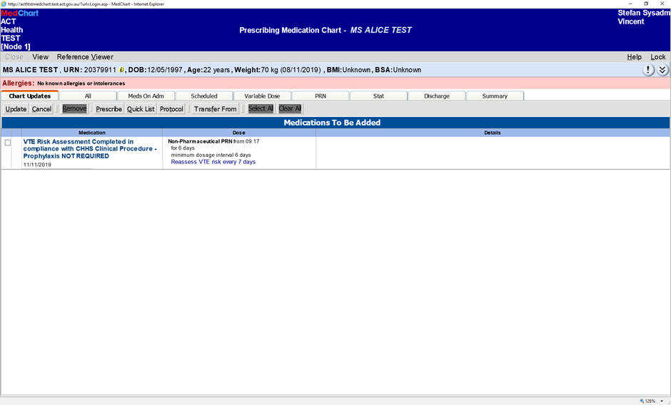
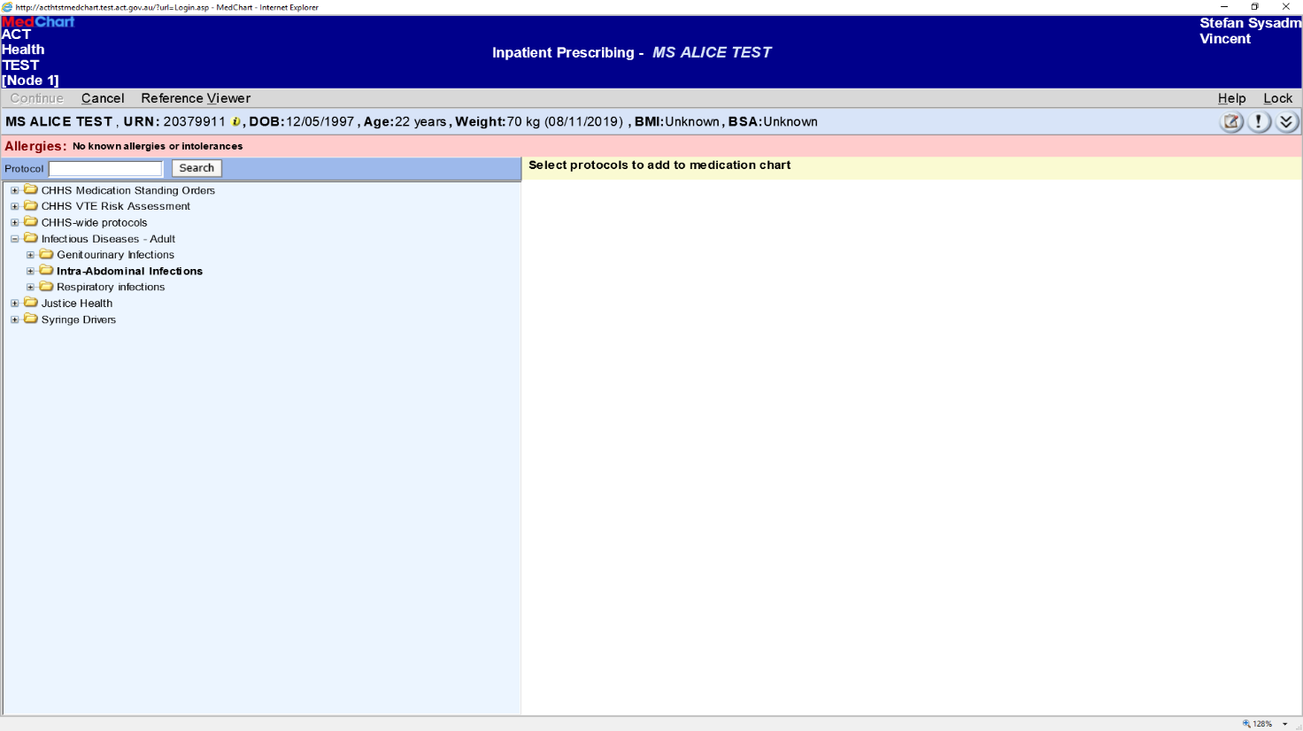
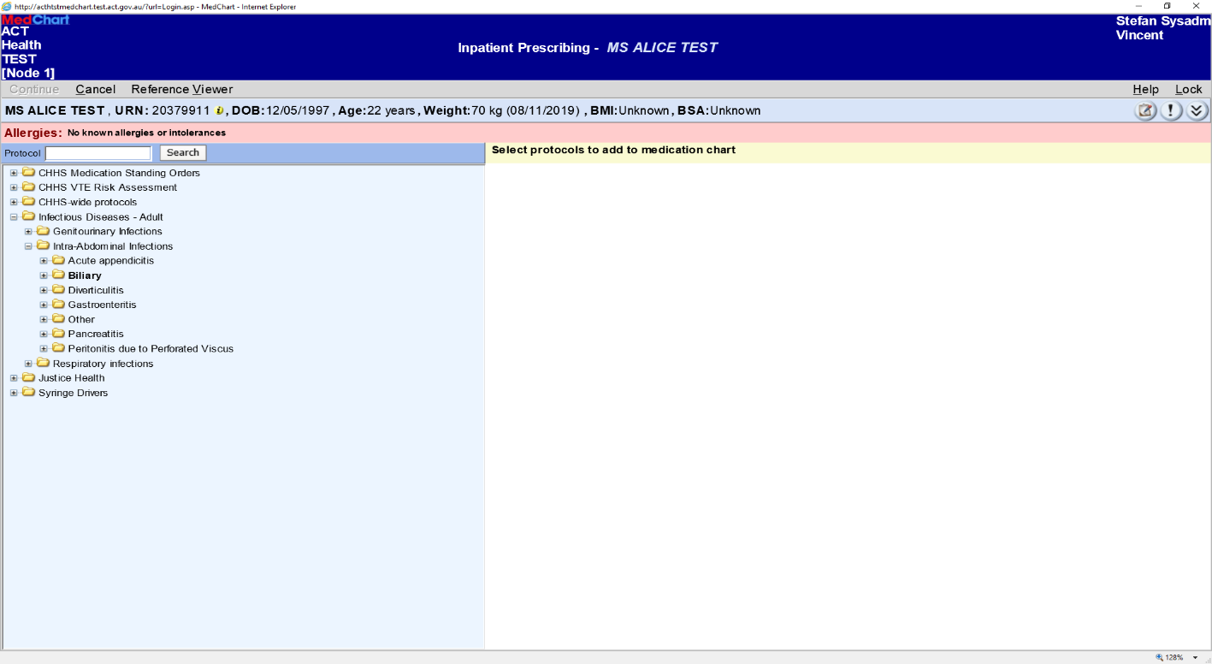

Slide 10
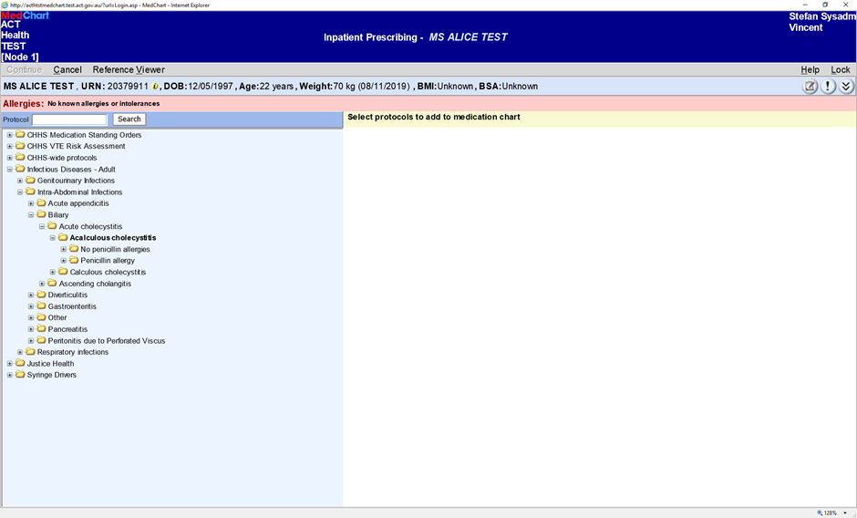
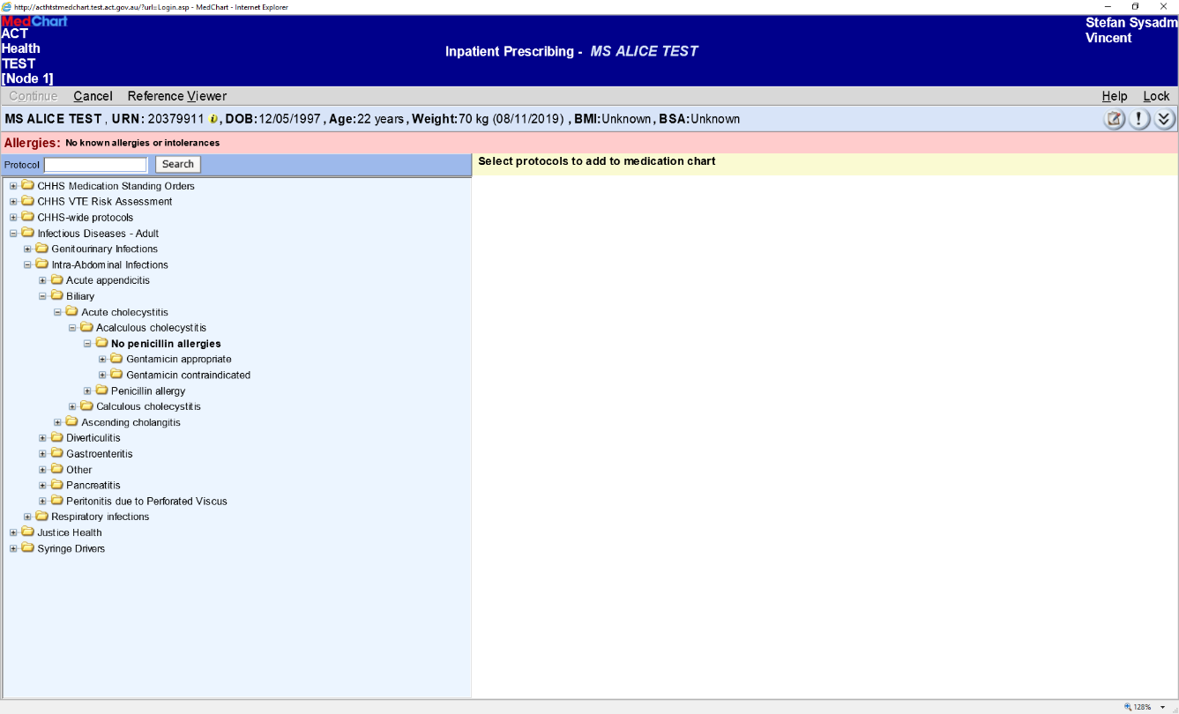
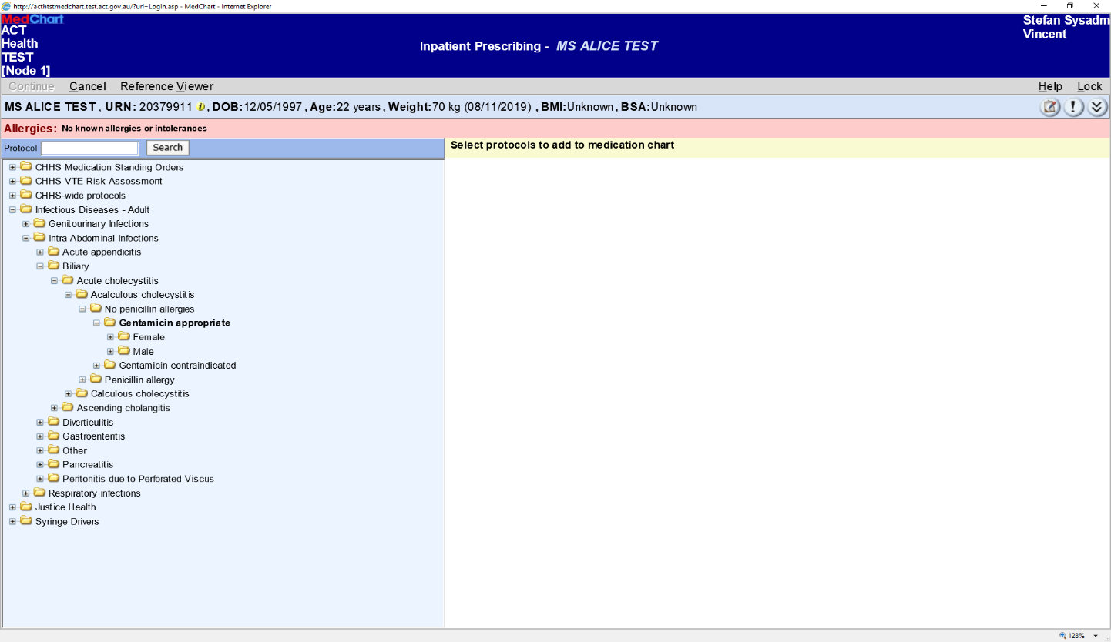

Slide 11
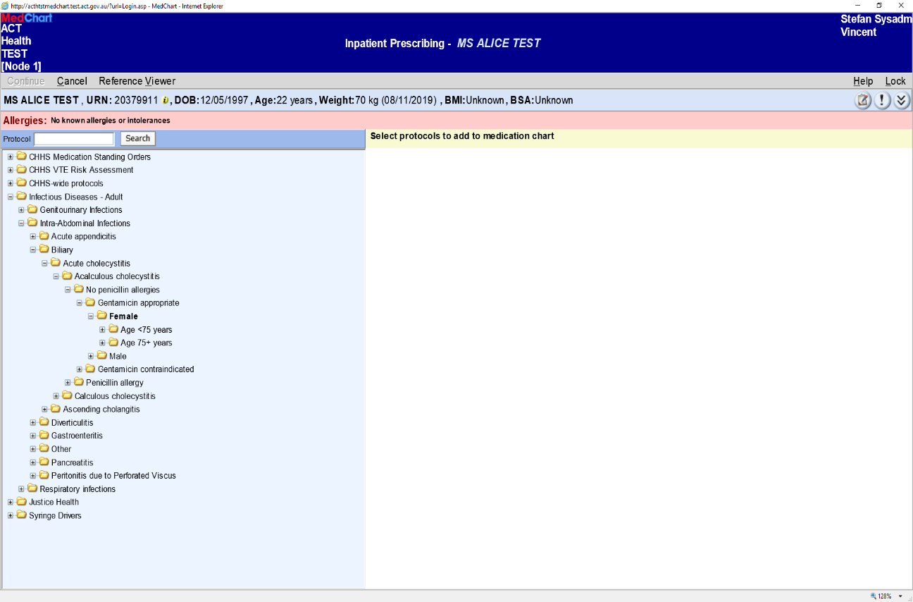

Slide 12
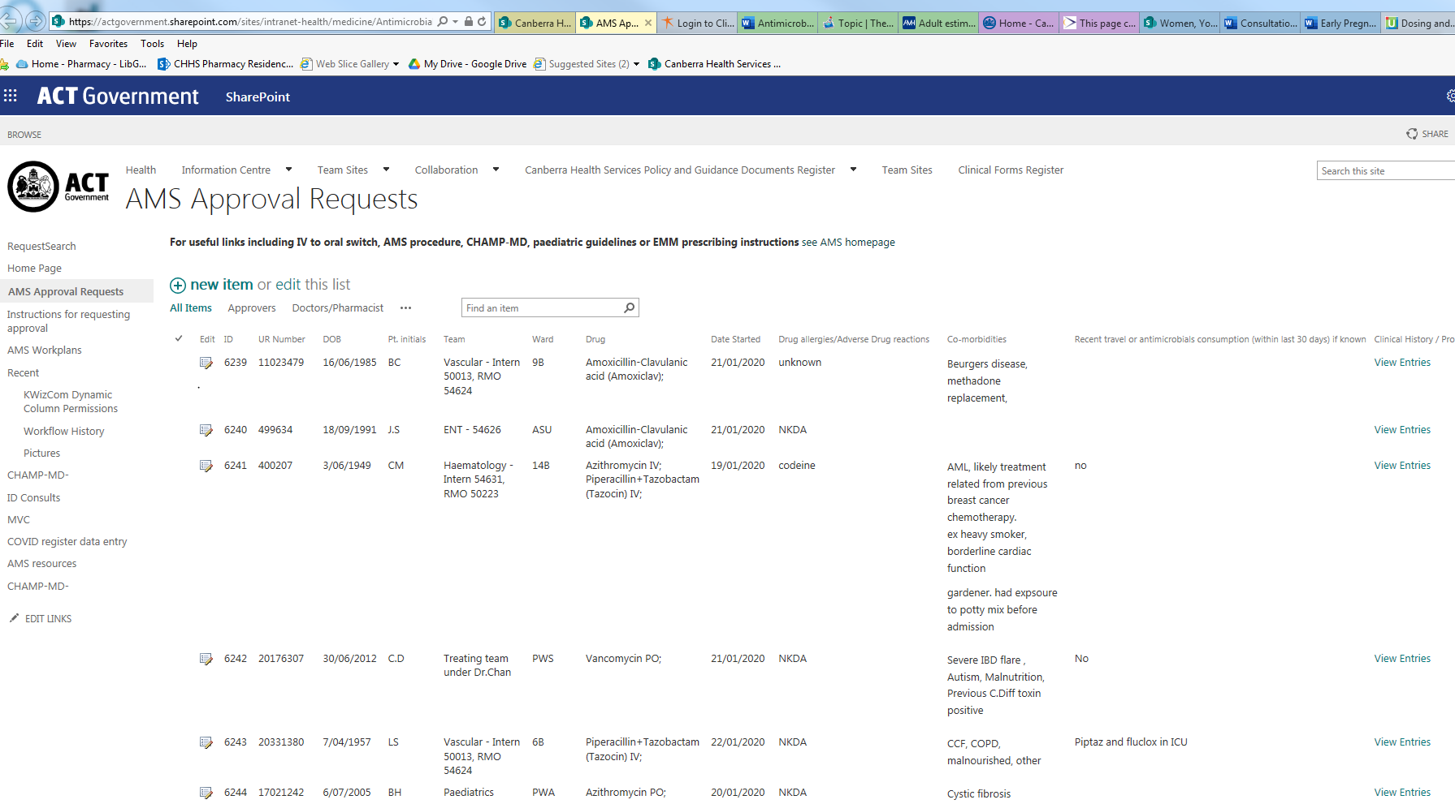
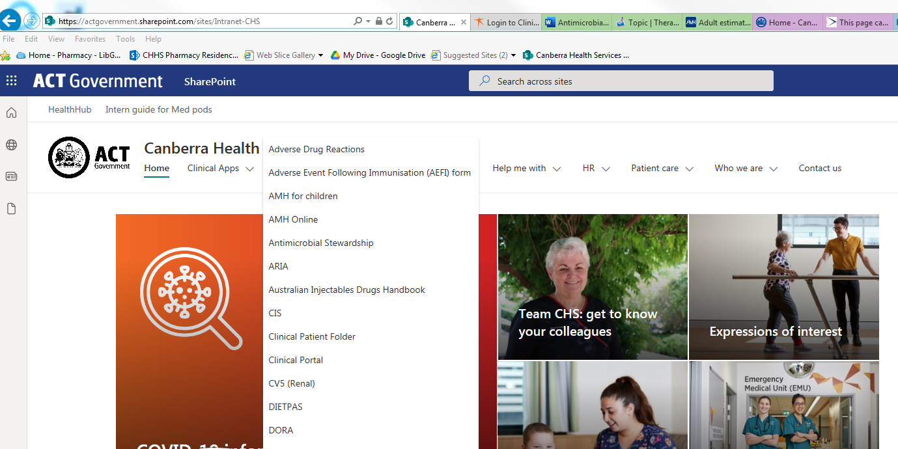

Slide 13
How long to treat?
“Usually, it is 5,7,10 or 14, based on the number of fingers we have or the number of days in the week. I think if we had 8 fingers and 12 day weeks, then patients would be getting some multiple of 8 and 12 days of therapy”-Mark Crislip

Slide 14
IV to PO switch – why and when?
Reduced morbidity and mortality (reduced line related infections)
Reduced LOS
Reduced workload
Reduced costs
Augmentin (IV 10x $$$)
Ciprofloxacin (IV 10x $$$) Metronidazole (IV 70x $$$)
In very simplified terms, switch to PO when:
Afebrile at least 48 hours
Clinically improvement, no SIRS/systemic toxicity
Can tolerate POs, no compromised GI absorption
IV to PO Switch Clinical Guideline for adult patients: Can antibiotics S.T.O.P., 2017,Government of South Australia
Notes:
The reason why it is important to switch patients

Slide 15
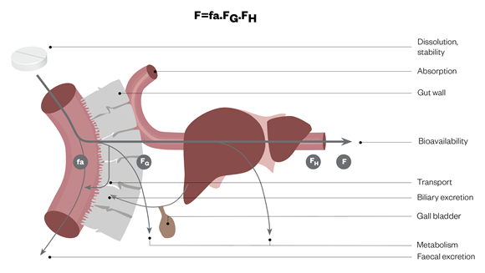
Ensuring adequate oral absorption
Nausea, vomiting, diarrhea?
NBM (Truly)
E.g. SBO
Not able to swallow liquid or tablets
Not being fed enterally
Hypoperfused: low BP, requiring fluid resuscitation
Reduced blood flow to gut
Significant bowel resection
Bowel obstruction/ischaemia
Malabsorptive syndromes
Mucositis
Information on where drugs are absorbed – Don’t rush to crush book
Tucker G, Pharmacokinetic considerations and challenges in oral anticancer drug therapy, 2019, The Pharmaceutical Journal

Slide 16
Questions?
melissa.faehrmann@act.gov.au
Ext 43378

